Slide 1
Covid Vaccine Facilitator
Sailaja Pattadari
Ramya Reddy Guda
Sahithya Edla
Rakesh Dasapathri
Value Propositions : Easy access to get vaccinated

Slide 2
Covid Vaccine Facilitator
It facilitates all the users to maintain their record regarding Covid vaccination. It provides the user a quick and easy access to the vaccination centers. It also track all type of record of vaccination centers to avoid any difficulties.

Slide 3
AI as the Solution
A chatbot will be implemented having AI support
Chatbot is responsible for all reservations
AI based chatbot consider all factors including limits and age factor etc.
All data will be generated in the backend according to chatbot.
Generated data will be used to generate a brief report

Slide 4
Concept and Justifications of solution
Cooking Frenzy is a latest project which launched recently on Google app store. Company Spent 1.2 years on this project.
The game is under Beta testing.
Vaccine become need these days.
It is very difficult to reserve your vaccination in vaccination center.
It is also difficult for vaccination centers to serve all the citizens at once.
This application facilitates everyone to reserve their seats accordingly.
Citizens can easily reserve specific vaccine for their reservation.
Vaccination centers also have data to see all reservations
This application helps to avoid any trouble in the vaccination centers.
The reports generated by the application helps to take decisions for further lockdown or SOP’s Implementation.

Slide 5
Market Research on current Offerings
This will be adopted by private vaccination centers as well as public sector vaccination centers.
Application will have two ends; one is for User and the other is for Administration.
Application distribution platforms like play store, becomes the backbone to spread the system.
Vaccination making companies also encourage the use of Vaccine facilitator.

Slide 6
Target Market and Value Proposition
Cooking Frenzy is a latest project which launched recently on Google app store. Company Spent 1.2 years on this project.
The game is under Beta testing.
All the public and vaccination centers are the vital target.
Vaccination becomes need and there is no related application.
It facilitates all the users to maintain their record regarding Covid vaccination.
It provides the user a quick and easy access to the vaccination centers.
It also tracks all the information of vaccination centers to avoid any difficulties.
User will use this application to perform vaccination and further queries.

Slide 7
Business Model and Development Approach

Slide 8
Business Model –Earning Point of View
Cooking Frenzy is a latest project which launched recently on Google app store. Company Spent 1.2 years on this project.
The game is under Beta testing.
Application have two types of earning mechanism
Ads related earning
There is no restriction to pay and avail the services. Ads will be shown after specific task performance. This free service will not provide certification.
Subscription based earning
Subscription will facilitate the user ad free environment and generate an official certificate of vaccination after vaccination is done. Doctor assistance is provided.

Slide 9
Members Expertise and Contributions
Sailaja Pattadari
Mobile applications Development Expertise, design whole application for user end.
Rakesh Dasapathri
Mobile applications Development Expertise, design whole application for Administration end.
Sahithya Edla
AI Bot Development Expertise, design AI bot assistance to operate all functionalities.
Ramya Guda
Report Analyst and Subscription method Designing Expertise, design report generator and design subscription mechanism.

Slide 10
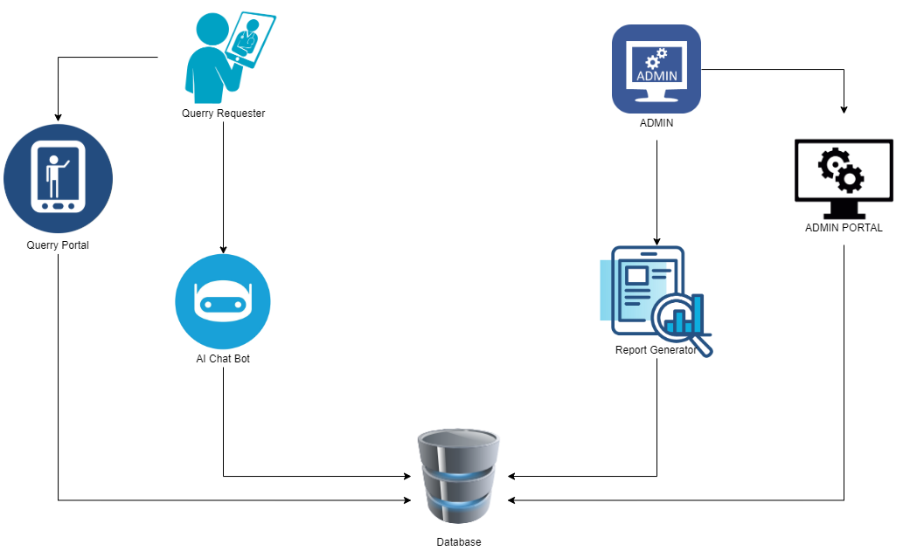
Roadmap to complete the Project
Cooking Frenzy is a latest project which launched recently on Google app store. Company Spent 1.2 years on this project.
The game is under Beta testing.

Slide 11
Tools and Techniques
Github
Google Authentication
Android Studio
Java
UI/UX or Custom Frontend
Anaconda
Jupyter Notebook
Python
Necessary libraries like tensorflow

Slide 12
Thank You

